Slide 1


ABAP on Hana s/4 Hana Training
Day 5
contact@anubhavtrainings.com

Slide 2

Agenda – Day 5
Performance Guideline for ABAP CODE
Describing SQLM (SQL Monitor)
Understanding Code inspector variants
Describing Data Migration Point
Static check with SQL performance
SQL performance Tuning work list monitor ( SWLT )

Slide 3
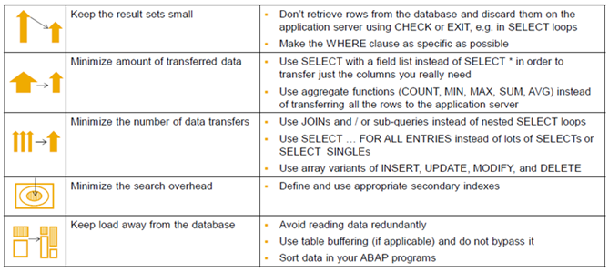
Performance Guild line for ABAP Code

Slide 4
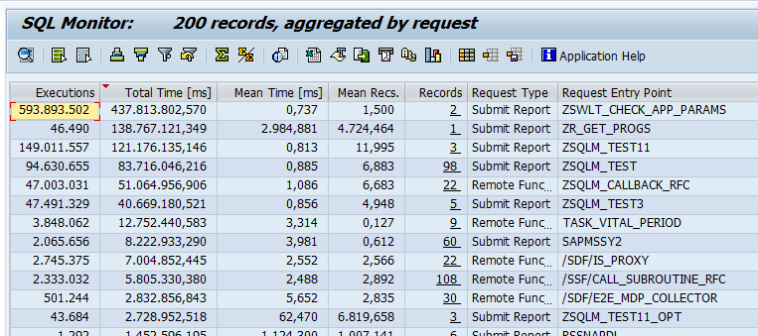
SQLM ( SQL Monitor )
This is a tool developed by SAP and available since NW 7.4 in all systems to monitor SQL statement performance in terms of DB Time, avg. time taken per request, DB Records, Iterations, over all consumption.
This is the recommended tool to be used in ABAP On HANA systems (production) w/o affecting performance.
Most expensive request entry point (Transaction, BG Job, Program, Report) In terms of DB Time
In these entry points itself, which SQL Query Dominates the SQL Profile
Most Expensive or Used Query in Whole System

Slide 5
SQL_M Architecture
When SQL Monitor is switched on
ABAP kernel logs information about DB accesses asynchronously via runtime monitor.
Monitoring data is moved periodically via a batch job to specific database tables.
SQL Monitor transaction reads data from these database tables.
Work Process
SQL Monitor Transaction
Runtime Monitor Data
Database Interface
Async.
Batch Job
SQLM Tables
Application Tables

Slide 6
SQL Performance Tuning Worklist
The SQL Performance Tuning Worklist (transaction SWLT) enables you to find ABAP SQL code that has potential for performance improvement. This tool combines information from static ABAP code scans that normally run in a test or quality system with runtime data from the SQL Monitor that typically originates from the productive system. Based on data records collected by the SQL Monitor, the SQL Performance Tuning Worklist automatically creates a worklist and allows you to rank the findings according to specific performance issues and their business relevance.
Findings from
SCI/ATC
Which are all
violation of
guidelines
SQLM tool for most
used and domination
SQL statements
Priorities

Slide 7
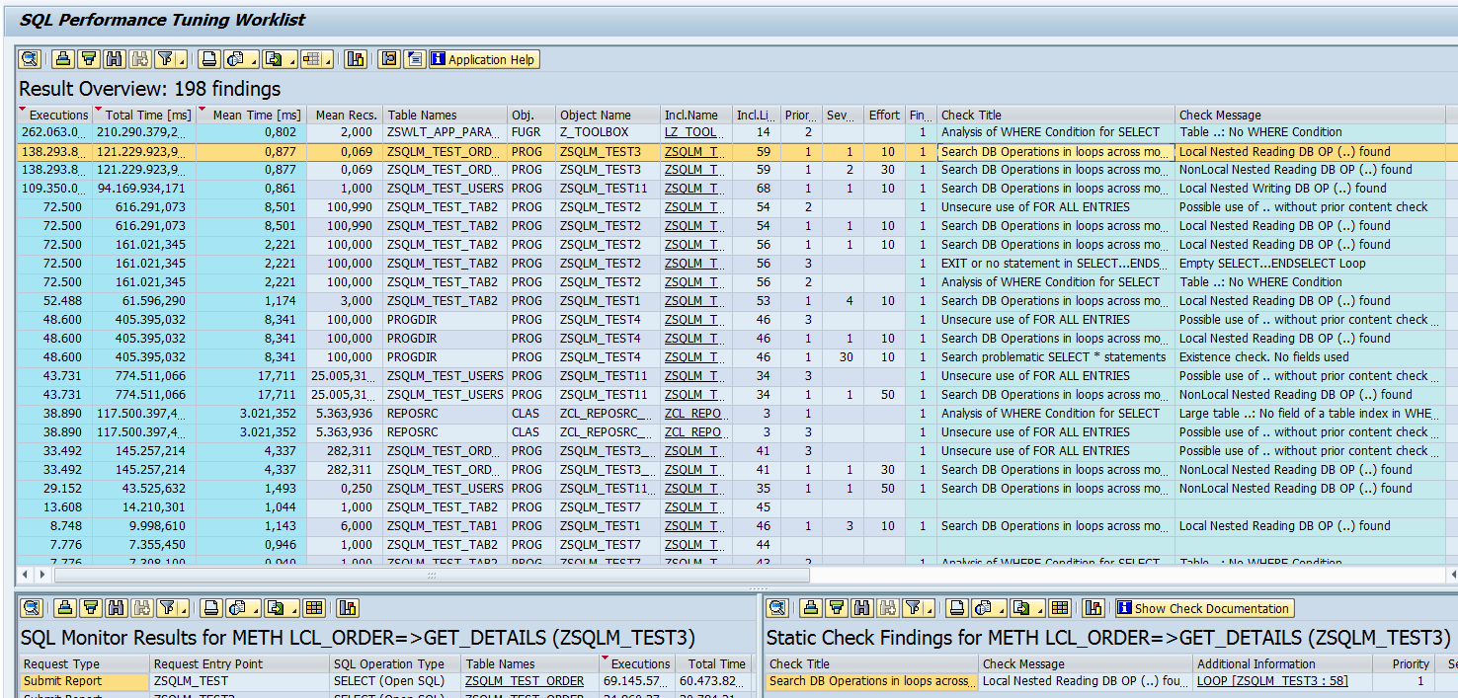
SQL Performance Tuning Worklist - Usage
Transaction SWLT provides a combined view with flexible navigation options
1
Ranked worklist
SQLM Data Different request entry points
ATC Results Detailed check results
2
3

Slide 8

Exercise 3
Performance DB Check

Slide 9

End of Day 5
Trainer: Anubhav Oberoy

Slide 10

Trainer: Anubhav Oberoy

Slide 11
THANK YOU
If you cannot do
great things, do small things in a great way.
Anubhav Oberoy
https://www.anubhavtrainings.com

Slide 12


We’re committed to empower you to be
Most Desirable Resource
through powerful training solutions.
We build the workforce of the future.
250+
Corporate Clients
30,000+
Learners Trained
25000+
Learners Placed
FREE WEBINARS
Sign up for free webinars with industry experts every fortnight!
Enroll Now!
Contact us today!
https://anubhavtrainings.com/

Slide 13




More from AnubhavTrainings.com

